Slide 1
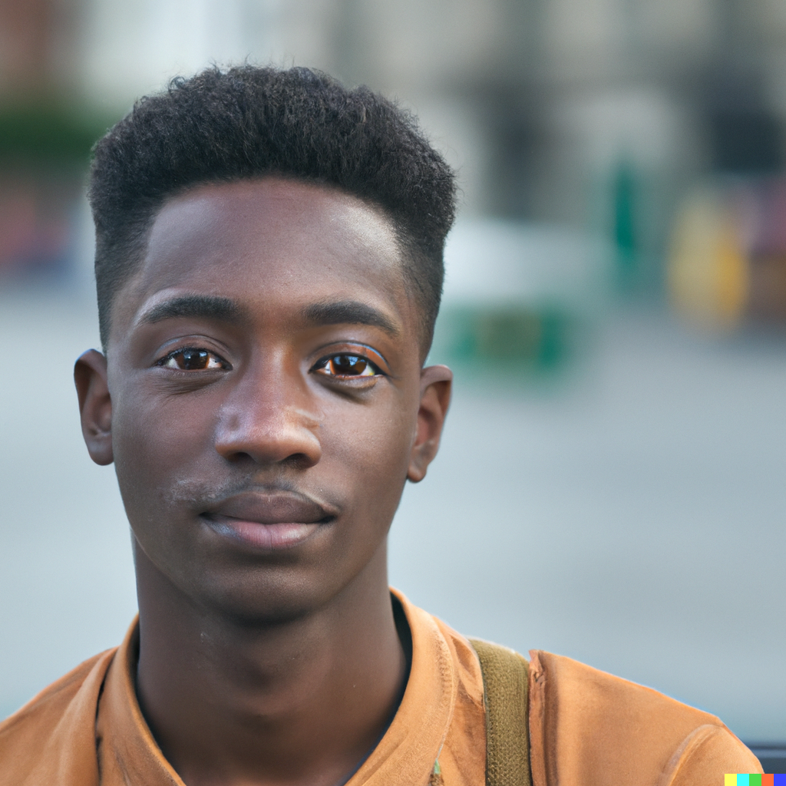
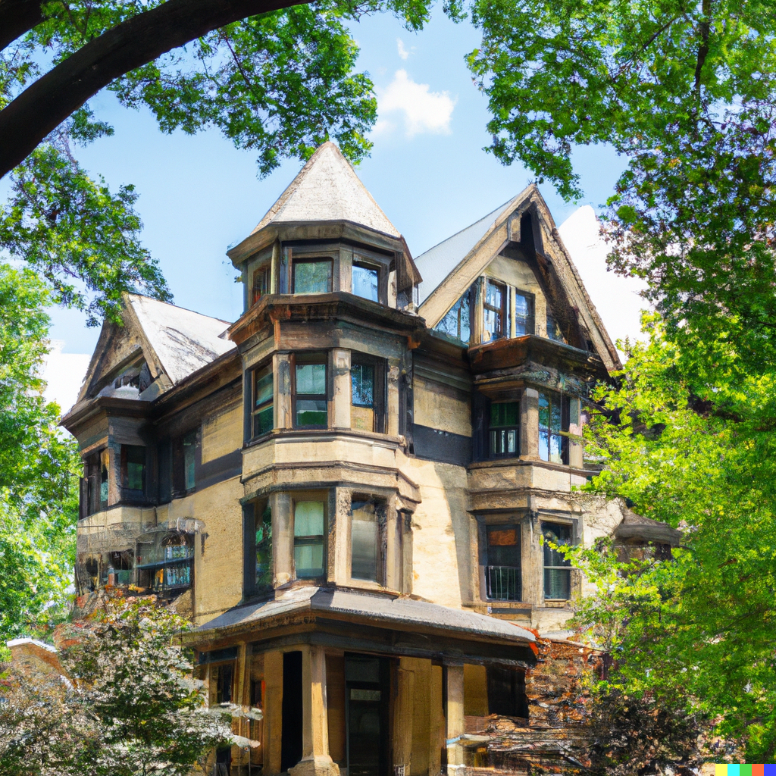
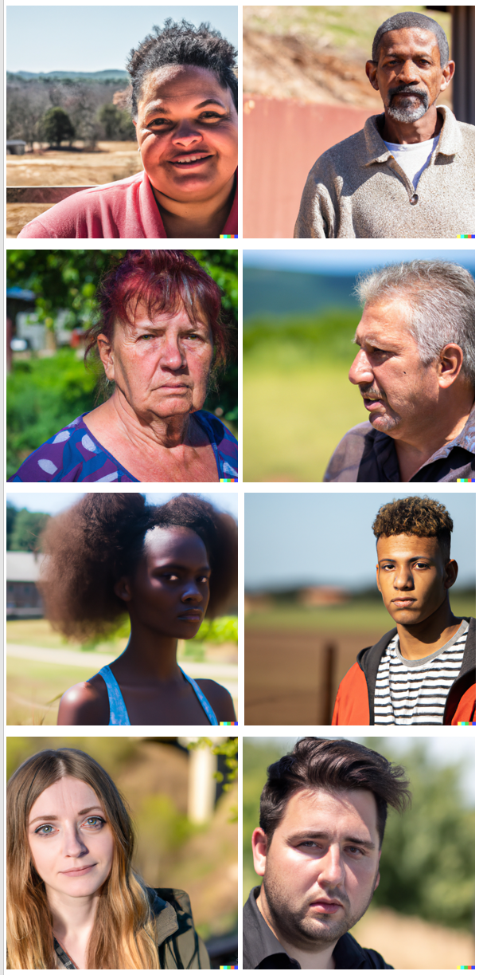
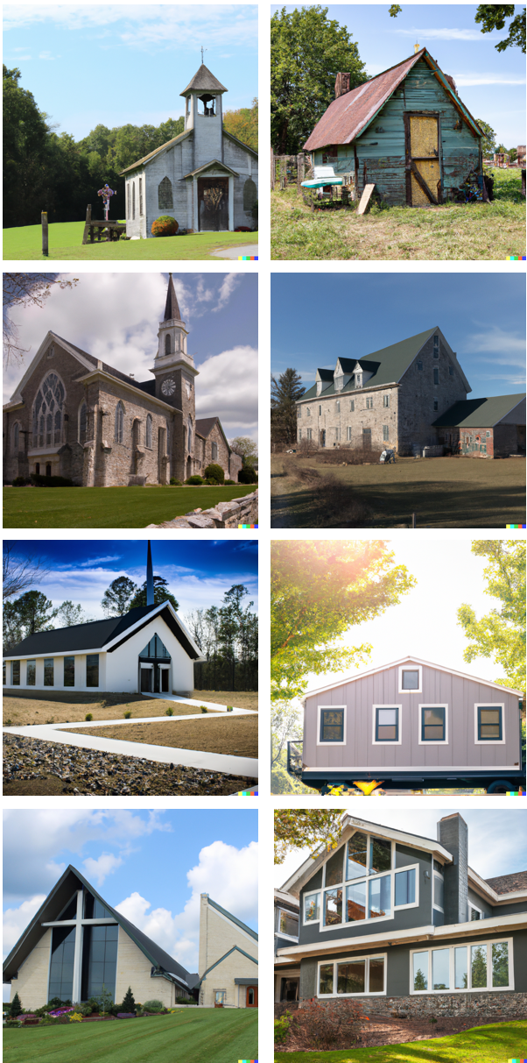
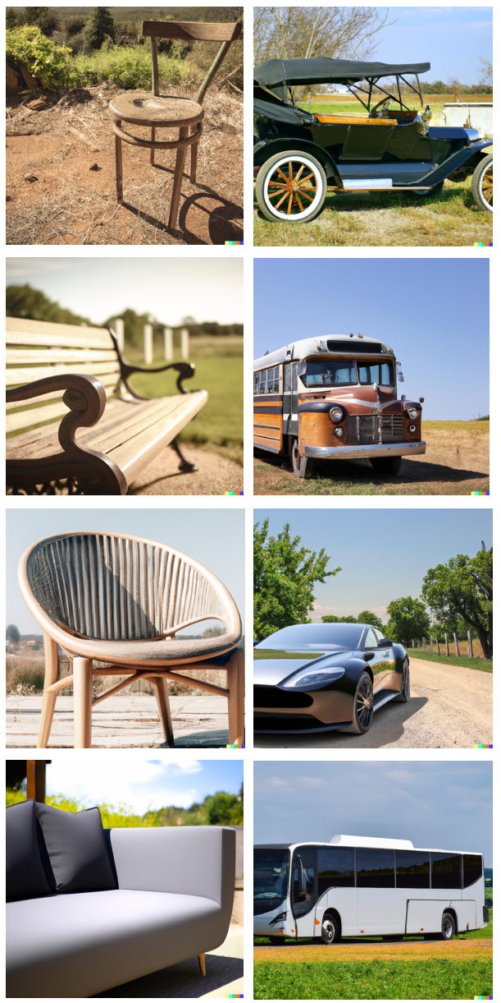
One trial
one-back number magnitude judgment
varying parity and magnitude of options
image encoding
image encoding
+
+
21 19 23 21 17 15 21 19 17 19 17 21
TR1
TR2
TR3
TR4
TR5
TR6
TR7
TR8
TR1
Study
image
decoding
target
number
decoding
target
One run
test1
test2
test3
trial number
1
2
3
4
...
...
24
randomize order
randomize order

Slide 2
randomize
within run
randomize
within run
randomize
within run
randomize
within run
first four runs
urban evening
urban day
rural evening
rural day
randomize run order
next four
urban evening
urban day
rural evening
rural day
randomize run order
last four
urban evening
urban day
rural evening
rural day
randomize run order

Slide 3
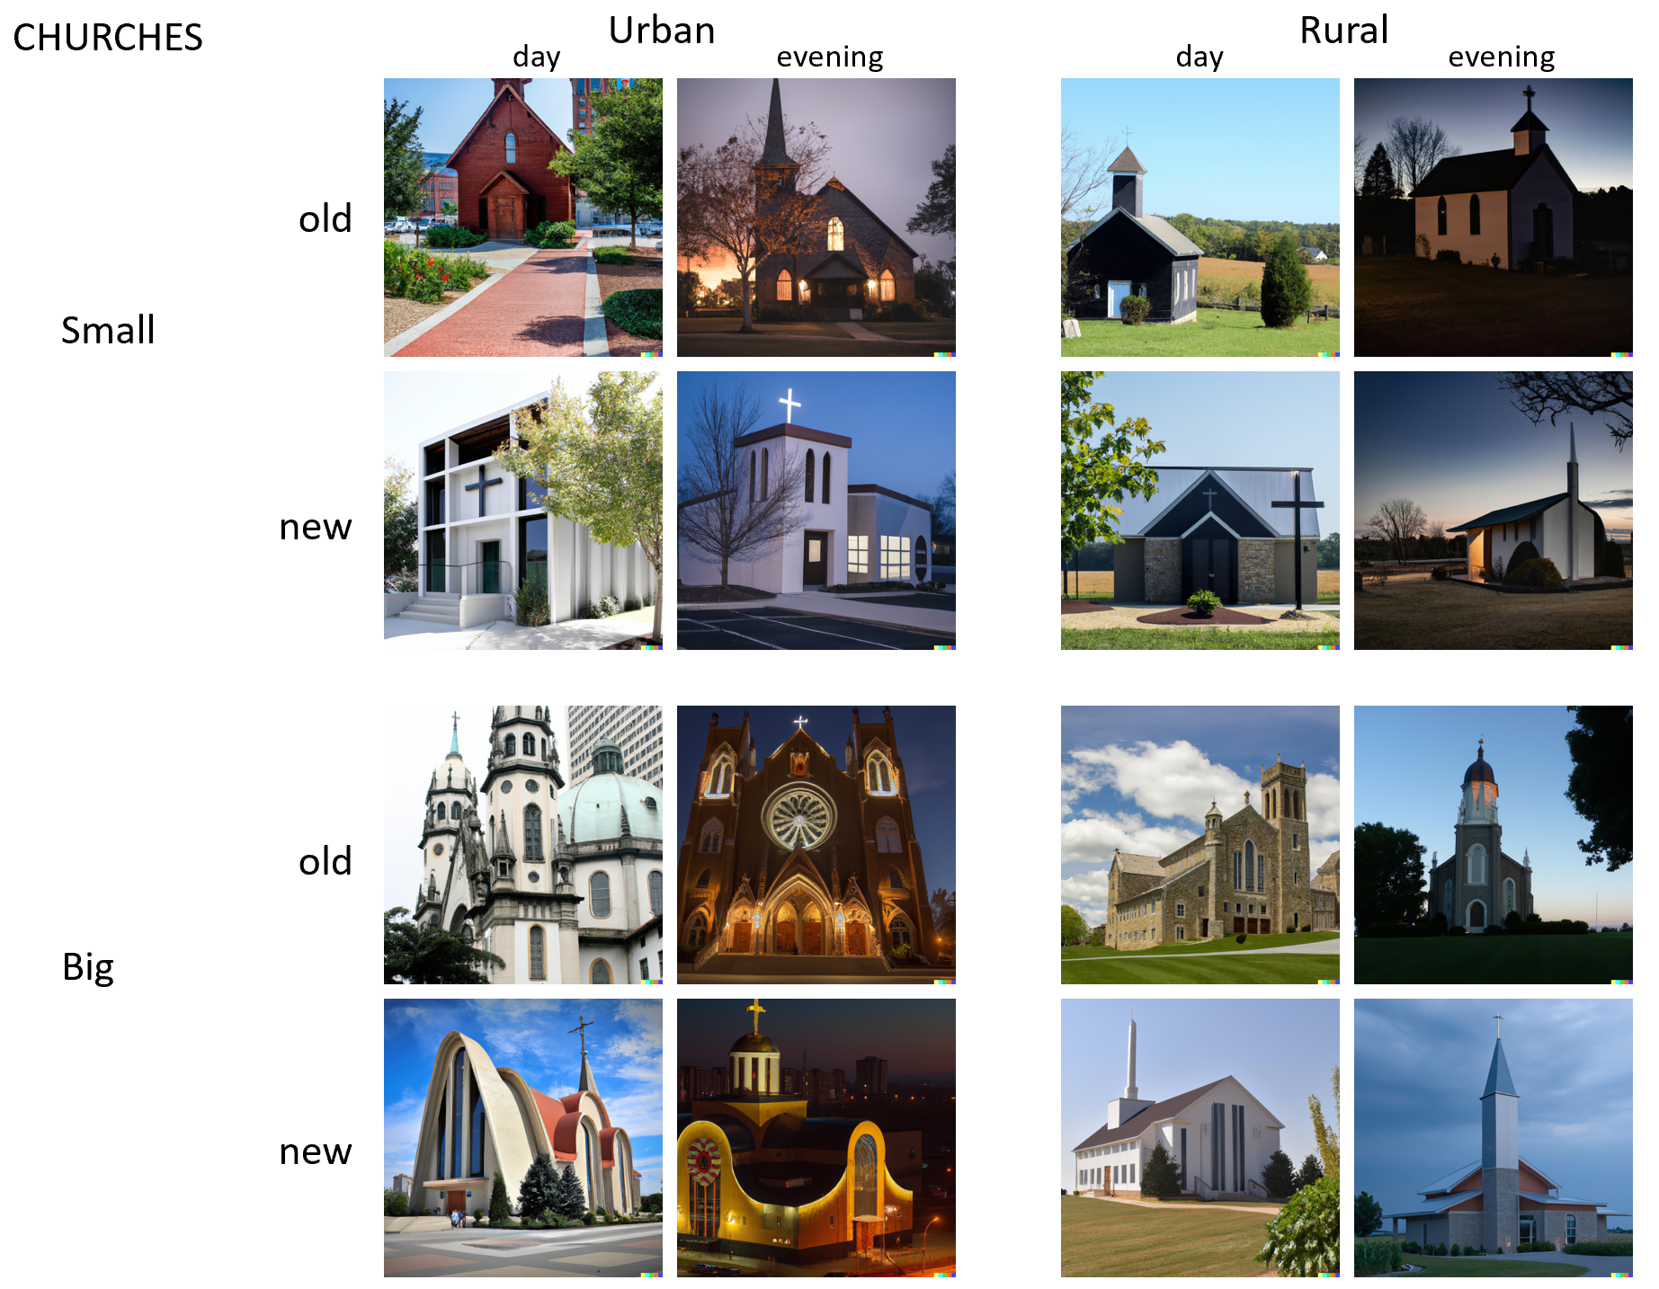

Slide 4
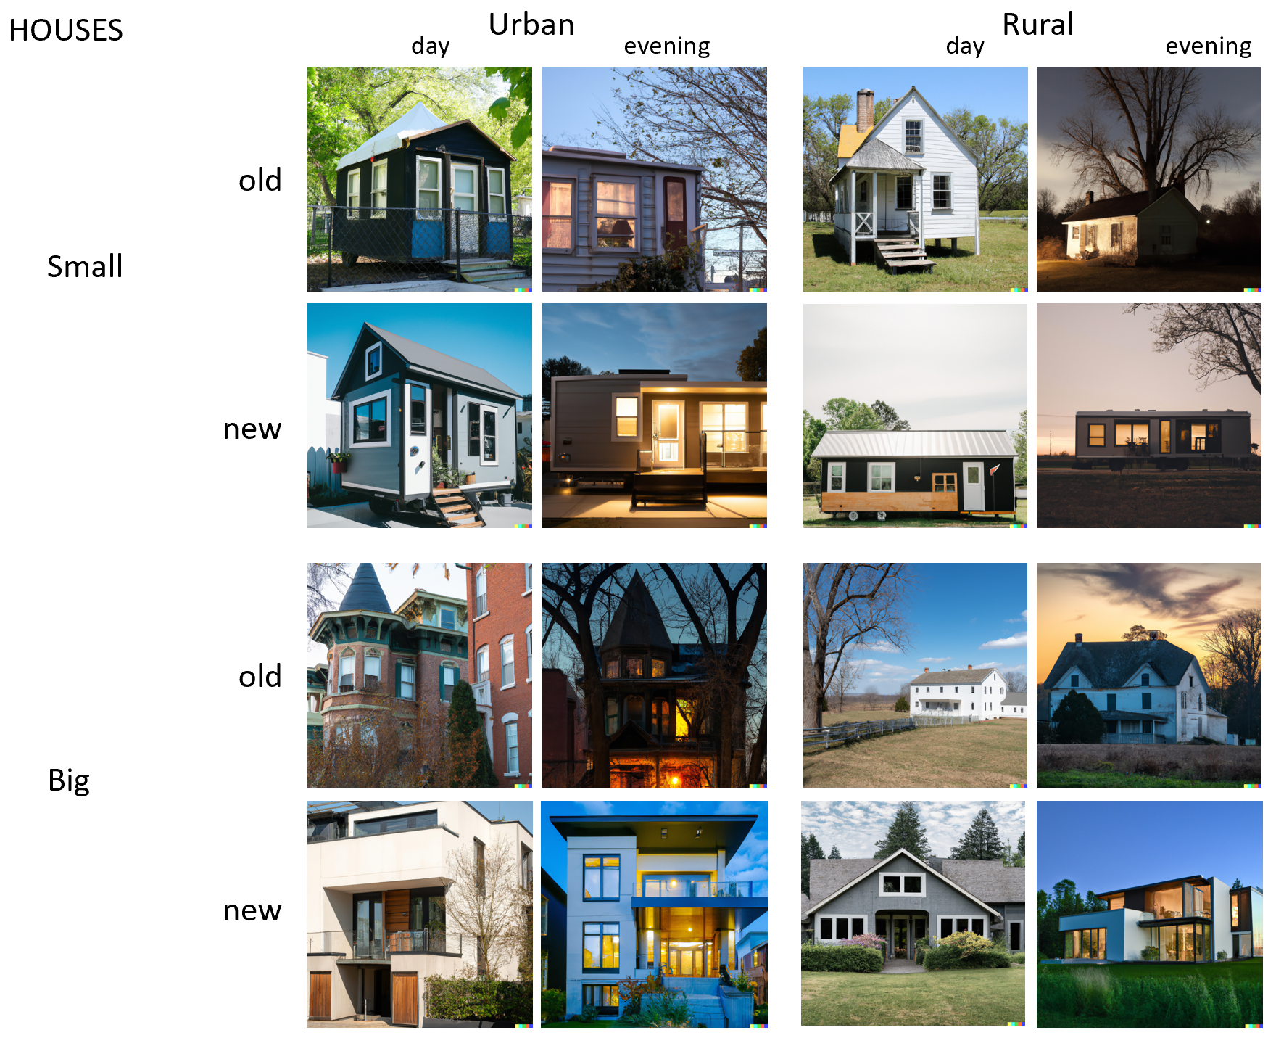

Slide 5


Slide 6
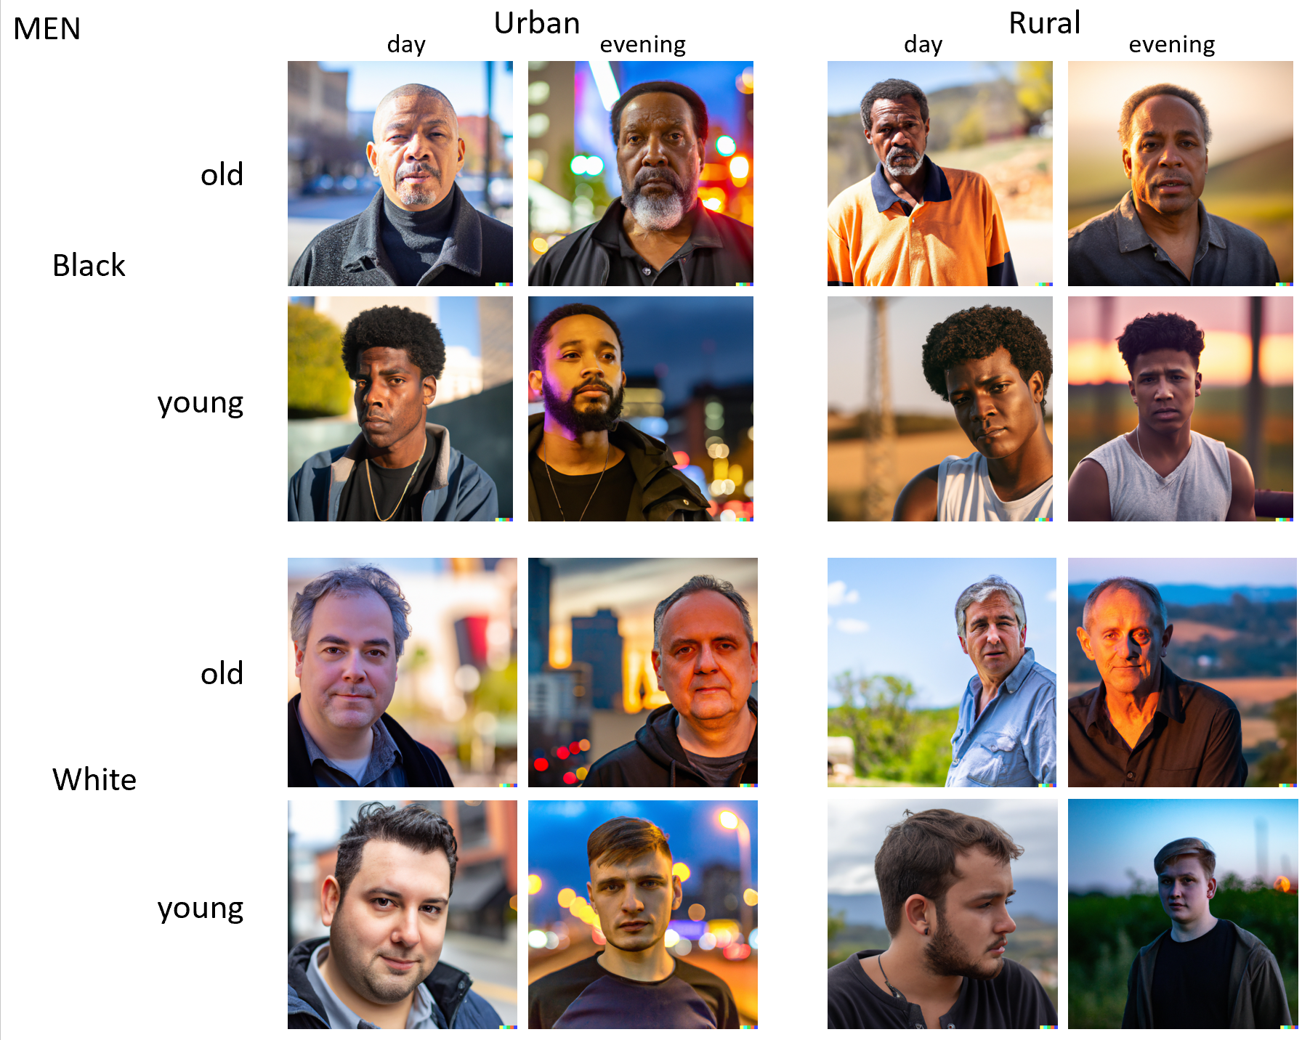

Slide 7
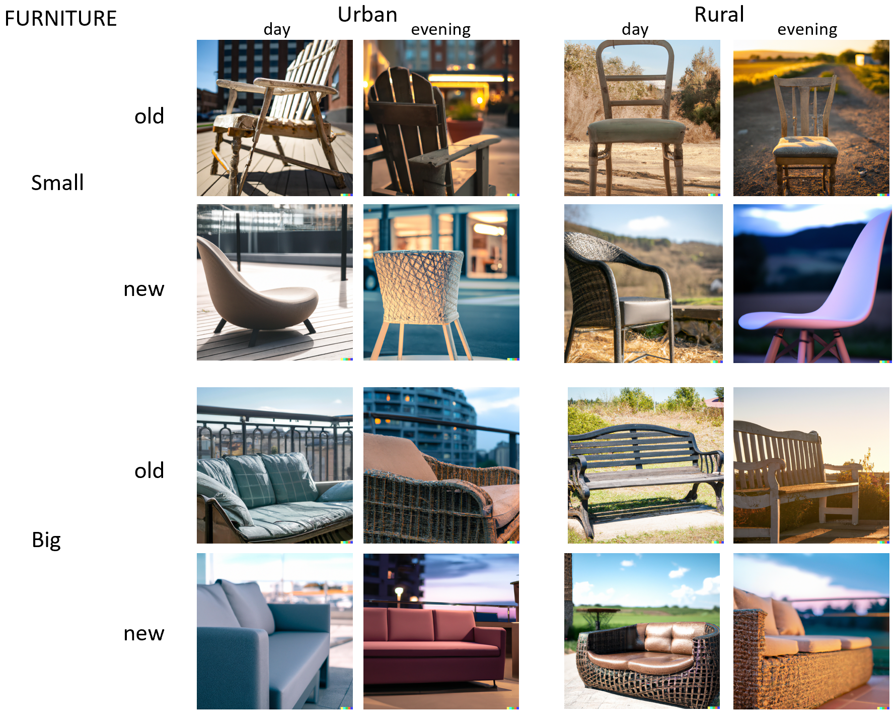

Slide 8
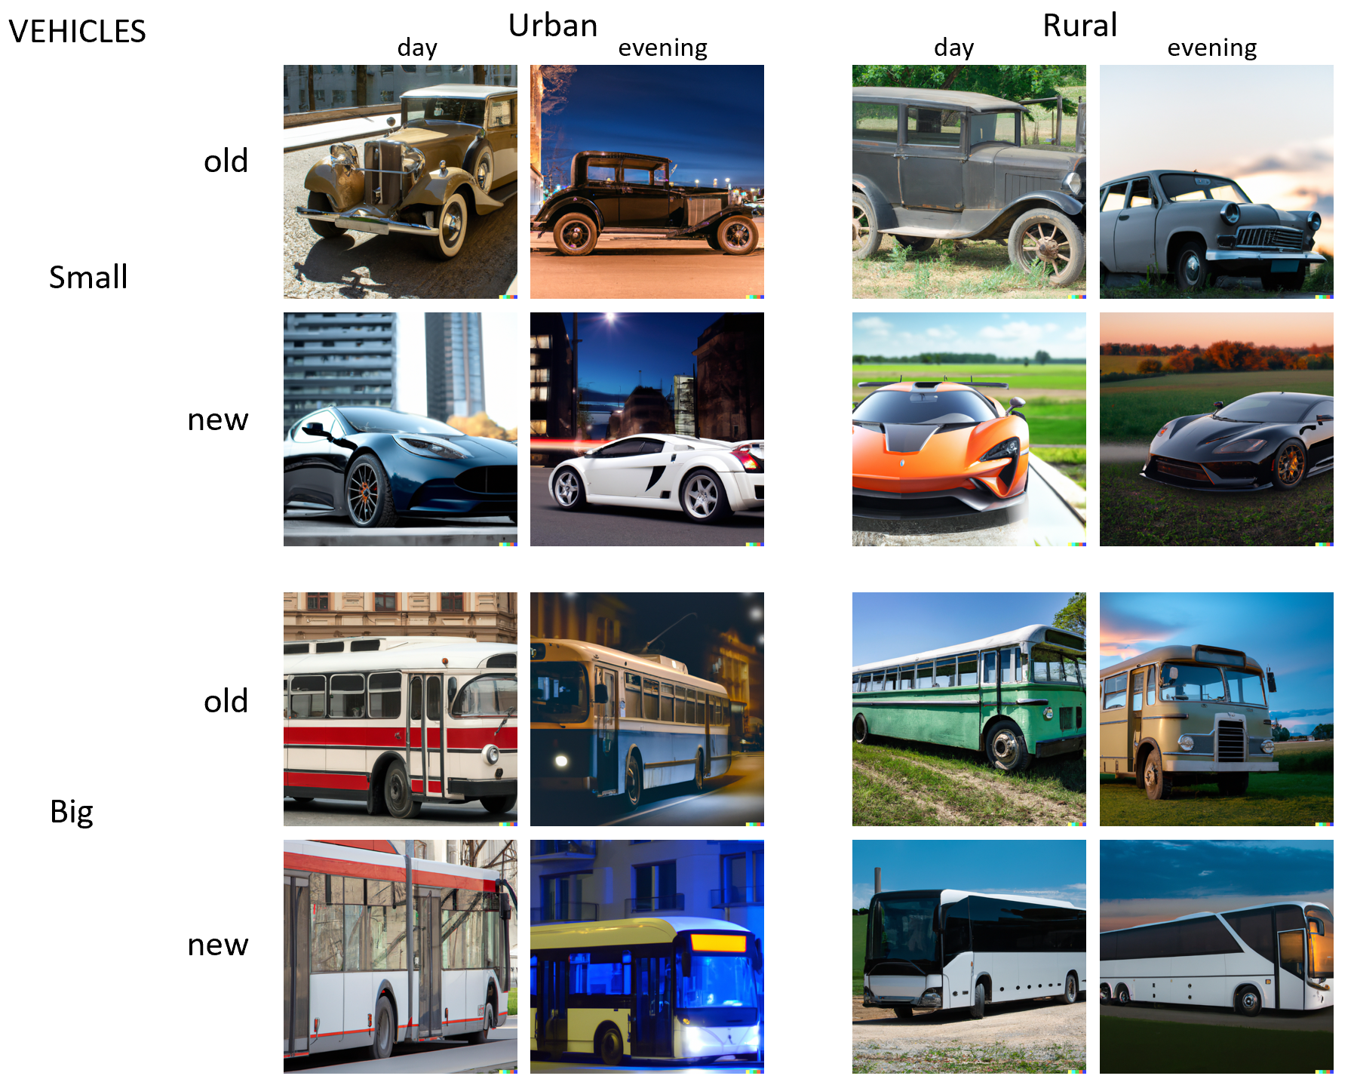

Slide 9
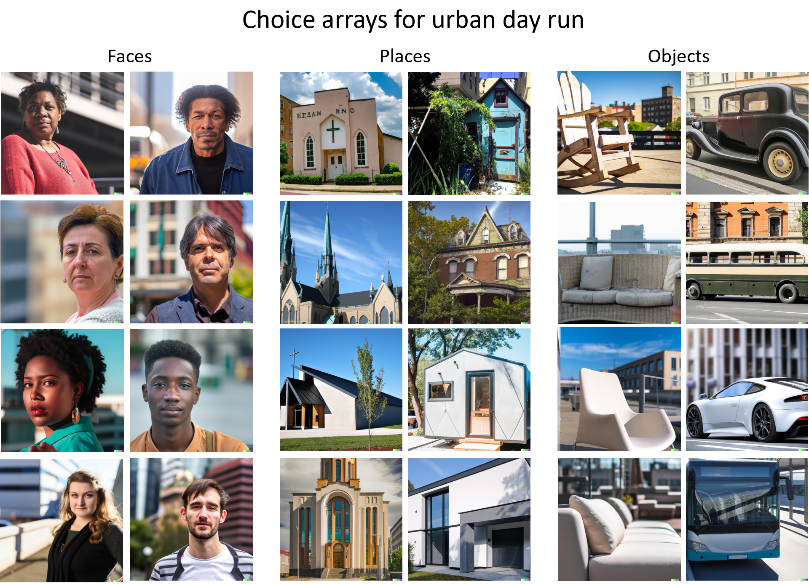

Slide 10
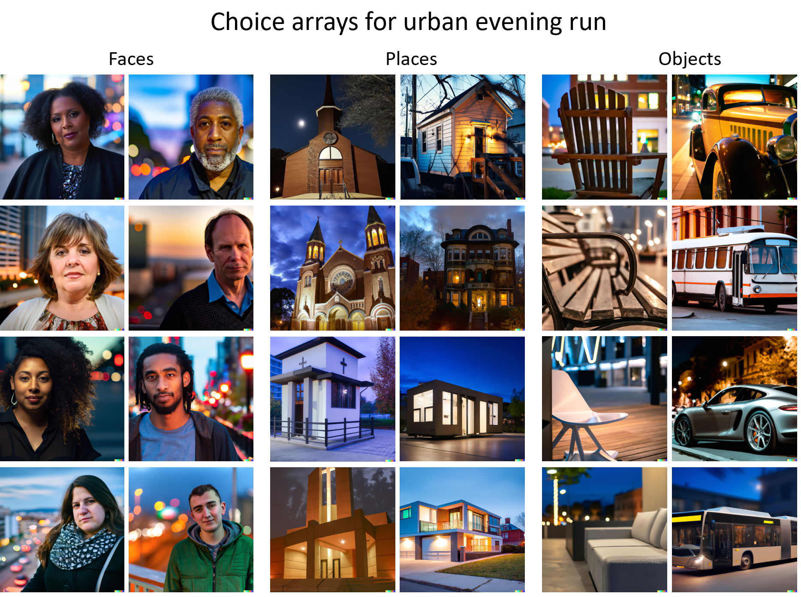

Slide 11
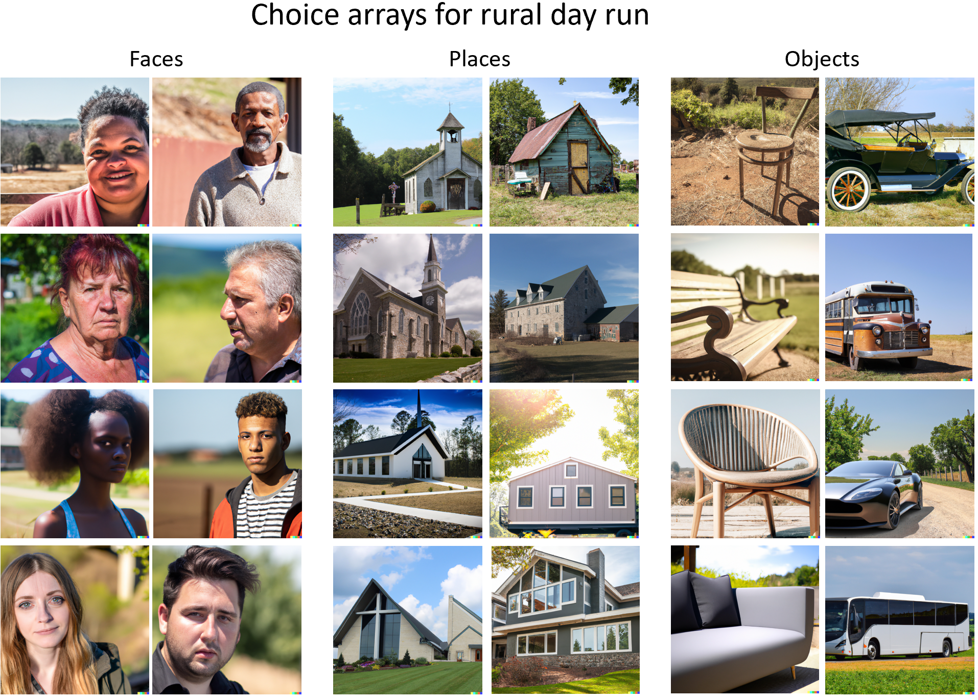

Slide 12
